Slide 1

Uk Poverty and inequality trends 1969 - 2017 : Insights from the world bank pip dataset
Source:
The World Bank Poverty and Inequality Platform (PIP) Dataset
Author: Teresa McGarry
https://pip.worldbank.org/home

Slide 2

Introduction

Slide 3
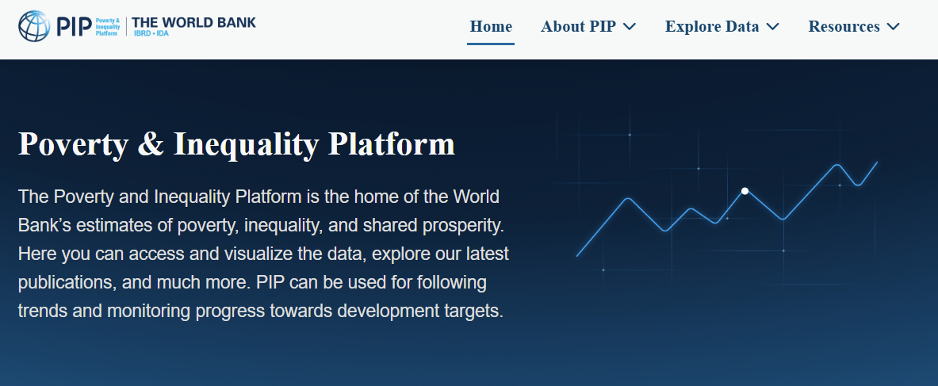
Project Introduction
UK Poverty and Inequality Trends, 1969–2017: Insights from the World Bank PIP Dataset
This presentation provides insights from the World Bank PIP Dataset focusing exclusively on the UK
It provides long‑term analysis tracking of poverty and inequality in the UK over nearly five decades (29 years' worth of data) using key poverty measures including Palma Ratio, Gini Index, Headcount ratio and Poverty Gap Index.
3

Slide 4
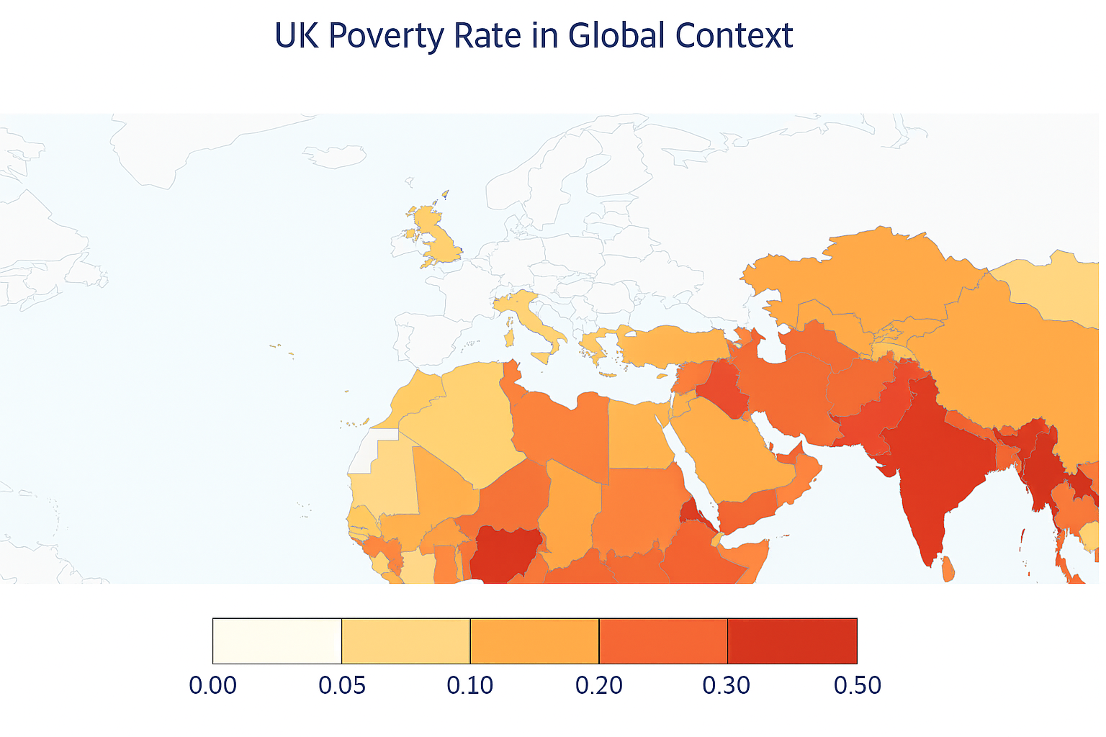
The PIP Dataset explained
The PIP dataset provides harmonized poverty and inequality measures across countries and time. Using it ensures that UK trends can be benchmarked against:
International income standards: $2.15/day, poverty lines
Lower-middle income: $3.65/day, poverty lines
Upper-middle income: $6.85/day poverty lines).
The dataset provides consistent time-series data (1967 – present) allowing tracking of decades of poverty dynamics
For the UK this is especially important since extreme poverty (international line) is rare, but relative poverty remains an issue
In a high-income country like the UK, the upper-middle income poverty line ($6.85/day) is the most appropriate one to review
Line Colour | Poverty Line Definition | Interpretation
🔵 Blue | International poverty line (e.g., $2.15/day) | Extreme poverty
🔴 Red | Lower-middle-income countries poverty line (e.g., $3.65/day) | Deprivation
🟢 Green | Upper-middle-income countries poverty line (e.g., $6.85/day) | Relative poverty & social exclusion

Slide 5
Why choose the Pip dataset

Slide 6
Motivation for choosing the PIP Dataset and specifically focusing on the UK as a case study
The World Bank’s PIP dataset offers a validated, respected, and globally harmonized perspective on poverty and inequality, covering 170+ countries across 50 years.
Its sheer volume makes it ideal for comparative analysis but also demands strategic scoping.
Focusing exclusively on the United Kingdom provided two key advantages:
It enabled an in-depth exploration of inequality and poverty in a single region without being overwhelmed by global complexity.
It offered a sandbox environment to:
Understand the dataset’s structure, variables, and features before scaling up.
Troubleshoot and refine code for reproducible analysis across other countries or regions.
Validate outputs for plausibility and consistency.
Develop and polish visualizations for clarity and audience impact.

Slide 7
Executive Summary & recommendations for further research

Slide 8
Executive Summary
Key Takeaways from the UK PIP Dataset Survey Trends (1969-2017)
Inequality:
Inequality indicators show modest but persistent increases across five decades, with notable fluctuations.
Peaks in inequality—especially in the early 2000s—appear across multiple measures, suggesting that during this period, the poorest became significantly poorer.
Poverty:
Relative poverty measures (e.g. Income Gap Ratio, Average Income Shortfall) show a steady upward trend, with sharp peaks around the early 2000s.
More concerning, extreme poverty (Headcount Ratio at the international poverty line) shows a slight increase over time, while the Poverty Gap Index reveals deeper and more persistent deprivation.

Slide 9
Recommendations for further research
Broaden the research scope by:
Comparing the UK with:
Other high-income countries or Western Europe
Use built in regional aggregates e.g. “World” and “High Income” or create new aggregate variables to deepen analysis
Make the analysis reproducible:
Build reusable region mapping dictionaries so that any country can be swiftly analysed
Create reusable functions for analysis and visualization for other countries
Make the presentation slide deck reproducible:
Create a slide deck that can be a template for further analysis with other countries or regions

Slide 10

Survey background

Slide 11
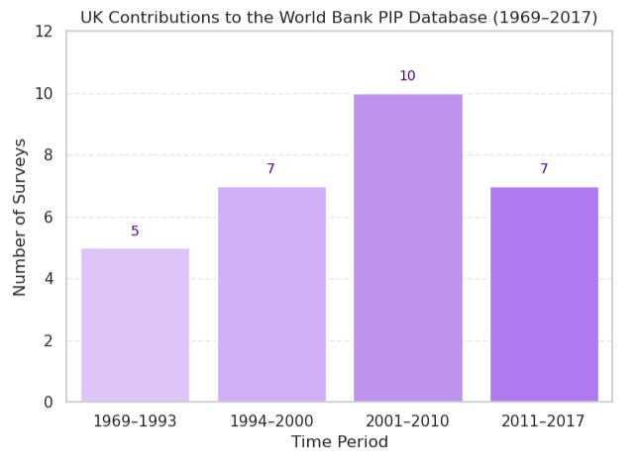
UK’s contribution to the PIP dataset is mainly from the mid 1990’s onwards
Survey
UK Contributions to the World Bank PIP Database (1969–2017)
1970s and 1980s: sparse surveys
1994 to 2017: consistent reporting: Near-annual data from 1994 to 2017, primarily via two government sponsored longitudinal surveys:
Family Resources Survey (FRS)
Households Below Average Income (HBAI)
Link: Family Resources Survey - GOV.UK
Link: Households below average income (HBAI) statistics - GOV.UK

Slide 12
Key variables
Variable name | Description | Measure
Mean | The mean level of income or expenditure per day. | Inequality
Median | The level of income or expenditure per day below which half of the population live.
Palma Index/Ratio | A measure of income inequality that compares the richest 10% to the poorest 40% of a population. It was developed as an alternative to the Gini coefficient, aiming to better capture disparities at the extremes of the income distribution.
Gini Index | A measure of income or wealth inequality within a population. It tells you how evenly income or consumption is distributed across the entire income distribution.
Polarization | The growing divide between high-income and low-income groups, often accompanied by the shrinking of the middle class. It’s a key concept in understanding inequality trends, especially in advanced and globalizing economies.
MLD (Mean Log Deviation) | A measure of income inequality that emphasises disparities at the lower end of the income distribution. It’s part of the generalised entropy class of inequality metrics and is especially sensitive to changes among the poorest.
Income Gap Ratio | The mean shortfall in income or consumption from the poverty line, expressed as a percentage of the poverty line, counting the non-poor as having zero shortfall. | Poverty
Average Income Shortfall | The average shortfall from the International Poverty Line per day (averaged across population in poverty).
Headcount ratio | % of population living in households with an income or expenditure per person below the International Poverty Line ($2.15 a day in 2017 prices) i.e. how many people are poor.
Poverty Gap Index | The depth of poverty by calculating how far below the poverty line poor individuals fall, on average, expressed as a percentage of that line. It complements the poverty headcount ratio by showing not just how many are poor, but how poor they are

Slide 13
Inequality measures

Slide 14
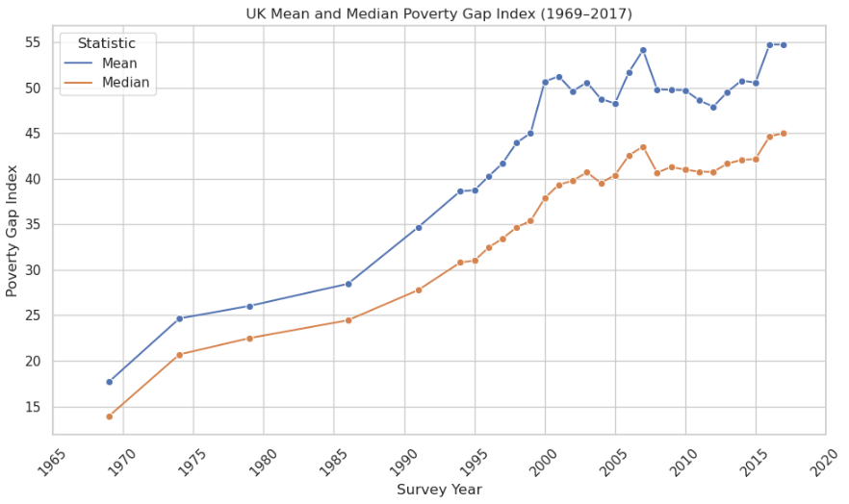
Mean and Median: The consistently higher Mean implies rising inequality among the poor i.e. the poorest became much poorer. 3 of the 5 largest (mean-median) gaps occur between 2000-2003
Interpretation
The depth of poverty is increasing — i.e., poor individuals are further below the poverty line on average (mean) and at the midpoint (median).
Year | Largest gaps Mean-Median
2000 | 12.80
2001 | 11.91
2007 | 10.58
2016 | 10.08
2003 | 9.89
NB A full set of mean-median gaps are shows in the Appendix

Slide 15
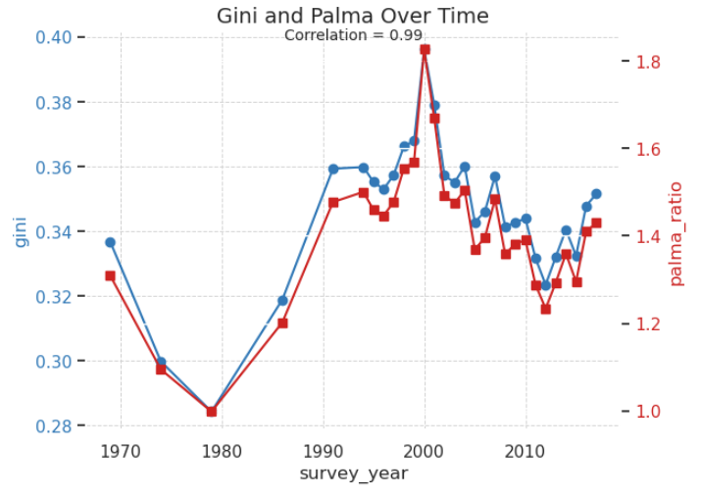
Palma Ratio and Gini Index: There is a strong positive correlation between these two inequality measures

Slide 16
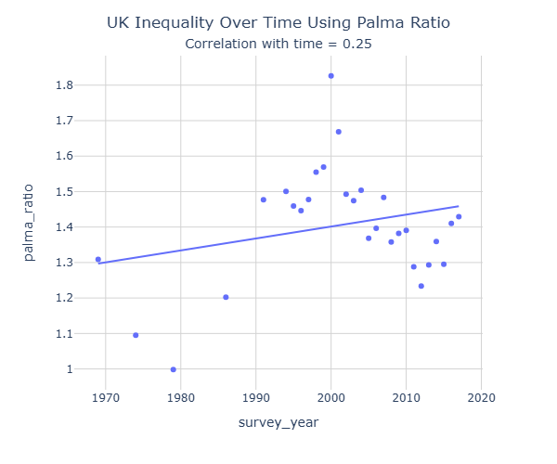
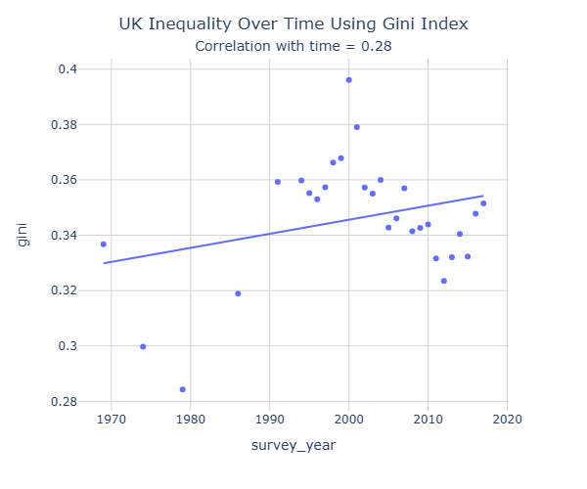
Palma Ratio and Gini Index: Both measures show that income inequality has risen modestly over time
Palma Ratio change 1969 vs 2017 | % change | Mean increase per interval
0.12 | 9.19% | 0.004
Interpretation
Whichever lens is used, the UK has become more unequal over the past 50 years.
Gini Ratio change 1969 vs 2017 | % change | Mean increase per interval
0.015 | 4.38% | 0.0005
Top 5 highest years
2000
2001
1999
1998
2004

Slide 17
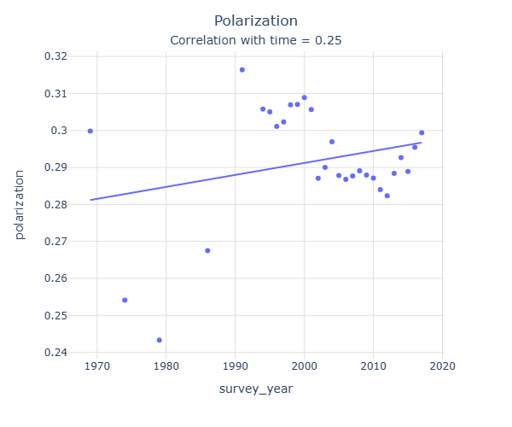
Polarization: While there is only a modest positive trend when comparing 1969 to 2017, there is a lot of fluctuation evident over this timeline
Polarization 1969 vs 2017 | % change | Mean increase per interval
-0.0005 | -0.16% | -1.69
Interpretation
The fluctuations in Polarization indicate that it is sensitive to short‑term shocks, but the long‑term story is still one of gradual increase.
Top 5 highest years
1991 | 0.316
2000 | 0.309
1999 | 0.307
1998 | 0.307
1994 | 0.306

Slide 18
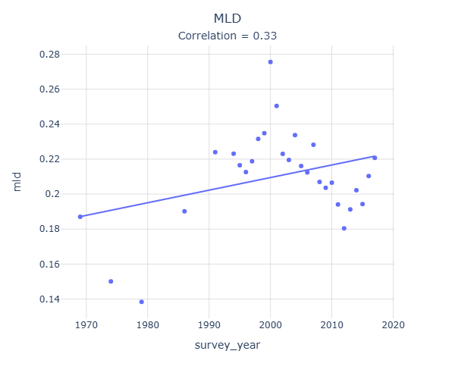
MLD: A slightly stronger positive relationship between time and inequality, with a further consistent upward trend in inequality
MLD 1969 vs 2017 | % change | Mean increase per interval
0.0337584 | -18.05% | -0.001
Interpretation
The fluctuations in mld indicate that it too is sensitive to short‑term shocks, but the long‑term story is still one of gradual increase.
Top 5 worst years
2000 | 0.275555
2001 | 0.250428
1999 | 0.234840
2004 | 0.233724
1998 | 0.231576

Slide 19
Poverty measures

Slide 20
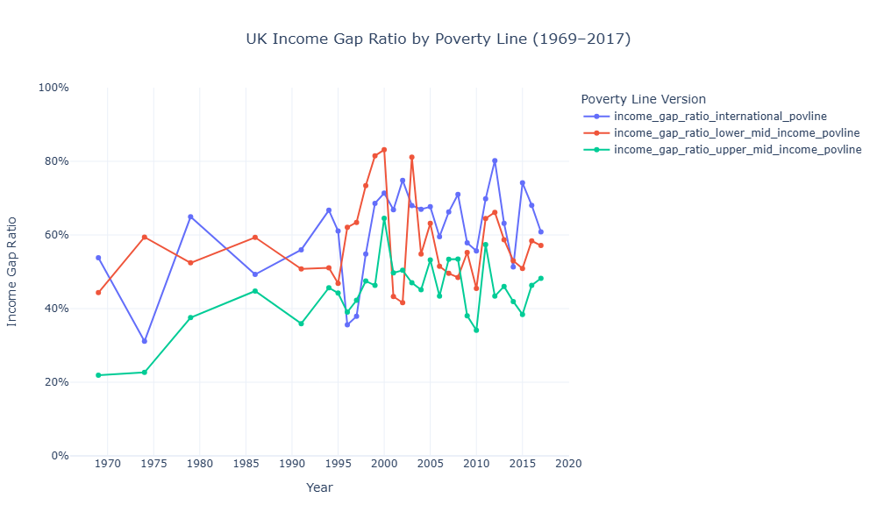
Income Gap Ratio: Whilst each poverty measure shows a persistent incline over time, the upper-middle income poverty line shows the largest increase
Line Colour | Poverty Line Definition | Interpretation | Ratio change 1969 vs 2017 | % change
🔵 Blue | International poverty line (e.g., $2.15/day) | Extreme poverty | 7.04 | 13.09%
🔴 Red | Lower-middle-income countries poverty line (e.g., $3.65/day) | Deprivation | 12.78 | 28.83%
🟢 Green | Upper-middle-income countries poverty line (e.g., $6.85/day) | Relative poverty & social exclusion | 26.27 | 119.80%
NB Because the poverty line threshold itself is fixed (e.g., international, lower‑middle, upper‑middle), the ratio is just a scaled version of the shortfall. The % change is identical for both Income Gap Ratio and Average Income Shortfall

Slide 21
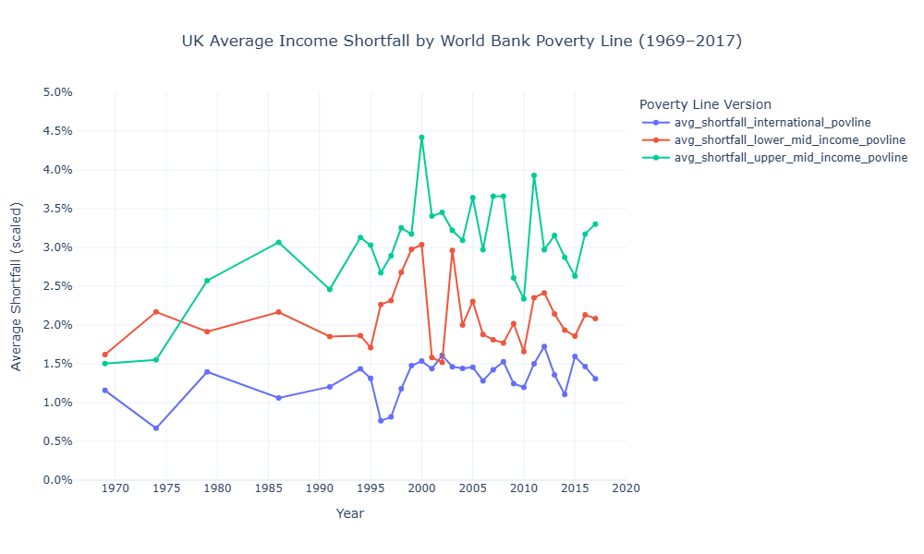
Average Income Shortfall: Again, the upper-middle income poverty line shows the biggest increase over time. There are notable spikes in each measure in 2000
Line Colour | Poverty Line Definition | Interpretation | Ratio change 1969 vs 2017 | % change
🔵 Blue | International poverty line (e.g., $2.15/day) | Extreme poverty | 0.15 | 13.09%
🔴 Red | Lower-middle-income countries poverty line (e.g., $3.65/day) | Deprivation | 0.47 | 28.83%
🟢 Green | Upper-middle-income countries poverty line (e.g., $6.85/day) | Relative poverty & social exclusion | 1.8 | 119.8%
NB Because the poverty line threshold itself is fixed (e.g., international, lower‑middle, upper‑middle), the ratio is just a scaled version of the shortfall. The % change is identical for both Income Gap Ratio and Average Income Shortfall

Slide 22
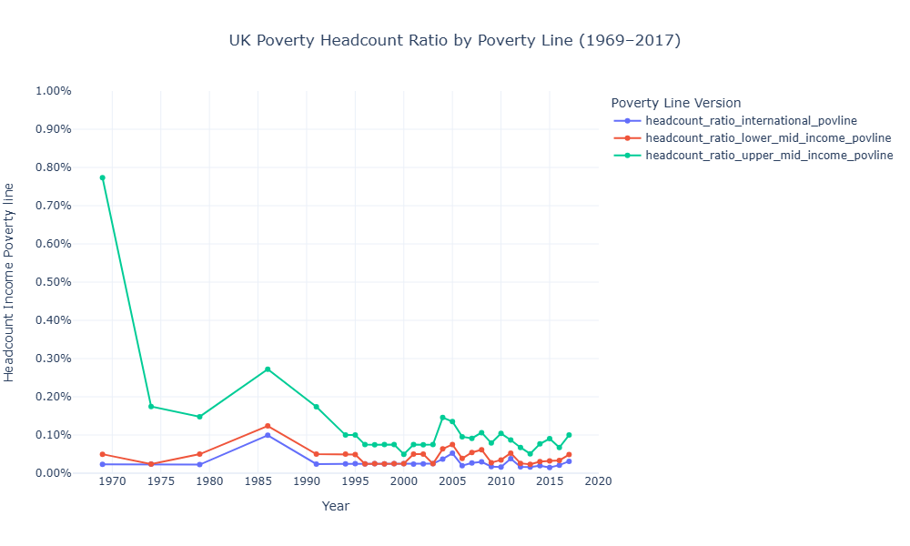
Headcount ratio: While fluctuations exist throughout the years, extreme poverty shows an increase over time
Line Colour | Poverty Line Definition | Interpretation | Ratio change 1969 vs 2017 | % change
🔵 Blue | International poverty line (e.g., $2.15/day) | Extreme poverty | 0.08 | 32.97%
🔴 Red | Lower-middle-income countries poverty line (e.g., $3.65/day) | Deprivation | -0.01 | -2.32%
🟢 Green | Upper-middle-income countries poverty line (e.g., $6.85/day) | Relative poverty & social exclusion | -6.73 | -87.08%

Slide 23
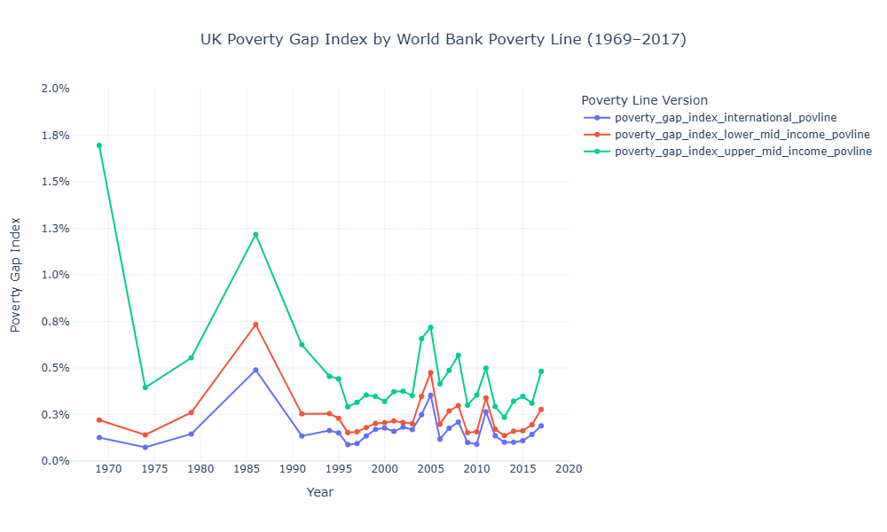
Poverty Gap Index: Extreme poverty is rare and stable. The upper-middle income line started high in 1969 but over time exposes deeper and more persistent deprivation. All lines show a peak in 1986
Line Colour | Poverty Line Definition | Interpretation | Ratio change 1969 vs 2017 | % change
🔵 Blue | International poverty line (e.g., $2.15/day) | Extreme poverty | 0.06 | 50.37%
🔴 Red | Lower-middle-income countries poverty line (e.g., $3.65/day) | Deprivation | 0.06 | 25.85%
🟢 Green | Upper-middle-income countries poverty line (e.g., $6.85/day) | Relative poverty & social exclusion | -1.21 | -71.60%

Slide 24
Appendix

Slide 25
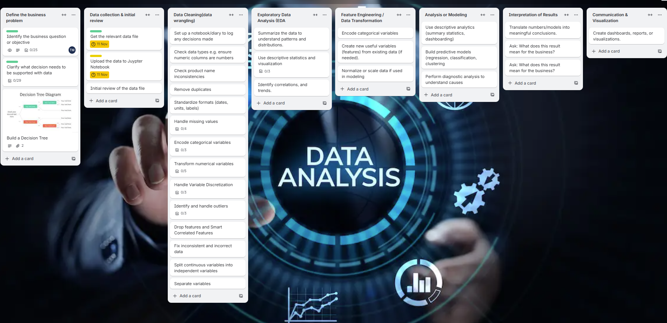
Project Management

Slide 26
Initial scope and project adaptation
Initial goal:
My initial goal was to use the full World Bank PIP dataset to explore poverty and inequality worldwide
I aimed to answer:
Which countries and regions are most affected?
Who has improved or worsened over time?
I had also planned to integrate GDP data for economic context
Early Challenges:
Both datasets were large and conceptually challenging
The creation of visualisations raised doubts, namely I wasn’t confident the results produced were accurate and correct
My limited subject knowledge made interpretation difficult
10/11/2025
UK PIP Dataset Explored
26

Slide 27
Project pivoting
I decided to “chunk” the dataset and focus solely on the United Kingdom which offered:
A manageable scope
A sandbox for learning the concepts involved in the PIP dataset and troubleshooting
A way to easily validate outputs before scaling up
Confidence that the data was accurate and explainable by cross-checking with the equivalent Excel dataset
10/11/2025
UK PIP Dataset Explored
27

Slide 28
Project reflections (1)
Spend (a lot of) time choosing and reviewing a dataset that:
Intrigues you: you genuinely want to uncover what it reveals about the world
Has concepts you can understand and explain clearly
Offers sufficient features and observations for valid and insightful analysis
Allows you to cross-check and validate any new variables you create
Start with a manageable scope:
Begin with a single country or region to build confidence before scaling globally
Use case studies to test your workflow and refine your approach
Validate at every step:
Cross-check outputs against trusted sources (e.g., Excel, documentation)
Use plausibility checks to catch errors early
10/11/2025
UK PIP Dataset Explored
28

Slide 29
Project reflections (2)
Build reusable resources:
Create region mapping dictionaries, plotting functions, and validation steps that can be reused across countries
Document your logic so others (or future you) can follow it
Visualize with clarity and purpose:
Be clear about what you want to say with the data
Customize plots for clarity, ordering, and audience impact
Annotate key trends to make findings accessible and compelling
Reflect and adapt:
Be willing to pivot your project scope when complexity arises
Treat challenges as learning opportunities to strengthen your analytical workflow
10/11/2025
UK PIP Dataset Explored
29

Slide 30
The PIP Dataset
Dataset Summary | Explanation
Purpose and Scope | The Poverty and Inequality Platform (PIP) provides the World Bank’s official global poverty and inequality statistics.
Frequency and Coverage | Data cover roughly 1967–2022 (depending on country). Around 2,000+ surveys are included. Updated quarterly, as new national survey data and PPP revisions become available
Data Sources | The dataset is built primarily from national household surveys (income or consumption-based). These are harmonized using consistent welfare definitions and PPP adjustments, allowing global comparability across time and countries (1980s–present).
Core Indicators | Poverty headcount ratios at international poverty lines (e.g. $2.15, $3.65, $6.85 per day in 2017 PPP). Mean and median income or consumption. Gini index (inequality). Income shares held by different population deciles or quintiles
GDP Alignment and PPP | Monetary values in PIP are expressed in 2017 PPP (Purchasing Power Parity) international dollars ($2.15/day (extreme), $3.65 (lower-middle), $6.85 (upper-middle)). Nb The dataset contains both the 2011 and 2017 definition of PPP. In this analysis we will focus solely on the 2017 definition. For macroeconomic alignment, it uses World Development Indicators (WDI) GDP and population data to ensure country-year consistency

Slide 31
Timeline of historical events 1969-2017 as a backdrop to poverty review
Year | Event
1969 | Townsend’s Poverty in the UK study: Redefined poverty as relative deprivation, shaping modern UK policy debates.
1979 | Thatcher reforms begin: Monetarist policies, privatization, and weakened unions; unemployment rose sharply, deepening poverty in industrial regions.
1997 | New Labour welfare-to-work: Tax credits and the New Deal reduced child and pensioner poverty.
2008 | Global financial crisis: Recession hit the UK hard, unemployment rose, and poverty increased.
2010 | Coalition austerity & welfare reform: Cuts to welfare and housing benefits disproportionately affected low-income households.
2017 | JRF report: 14 million in poverty: Highlighted persistent poverty, with child poverty rising again despite earlier progress.

Slide 32
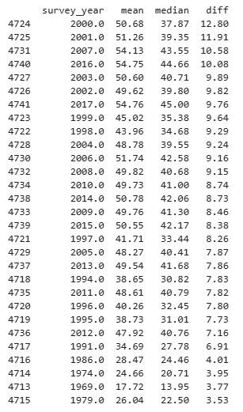
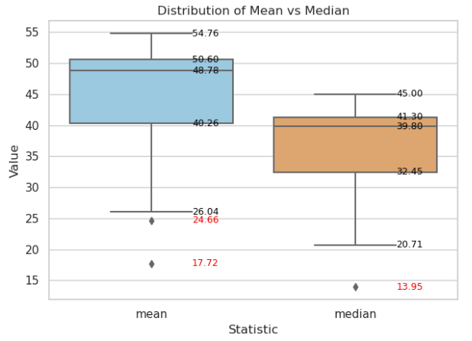
Mean and Median: The mean is higher than the median. This implies a positively skewed distribution

Slide 33



Thank you
Teresa McGarry
teresa_mcgarry@hotmail.com
GitHub: mcgarryteresa39-stack/individual-project-teresa

